Slide 1
ANDROID BOOTCAMP 2021
Presentation subtitle

Slide 2
AGENDA
Framework/Platform | System & App | Framework/Platform II | GAS Partner
Keynote |  | Google Cloud | Design for Driving
Car Framework | System UI | Telemetry | AA Receiver
Virtualization | Car Messenger / SMS v2 | Sensing & Location | Upgrade Program
Audio | Rotary Update | Digital Car Keys | Unbundling
Display & Input | Customization | Multi-User | Car Calendar
Networking | Developper for Cars | Device Policy Mgt | SUW
Bluetooth | Developper Tools | Security | VMS Powertrain Analyzer
Camera Surround View | Multi-screen | AAOS Compliance | Vehicle Energy Model
Camera EVS | Quality | Test Infra & Tools | Vehicle Contributions

Slide 3
KEYNOTE – Do More with Google
https://www.youtube.com/watch?v=L8XcEGtQYx4&t=11s

Slide 4
Impacts
Domain (JIRA ticket) | Feature | Impacted SW Component | Must / Recommended / Optional
Build, SePolicy, Permissions | Move Android.mk to Android.bp Lib 64 bits or Lib 32 bits only according to RAM | All | Must
Power ( CCSEXT-52780 ) | Add Silent Mode (device starts with display and audio off) | AllianceCarPowerService, AWOS, CarAudioService | Must
User (CCSEXT-42033, CCSEXT-25471, CCSEXT-42039 ) | User HAL (in VHAL) eases multi-user mgt (for ex : Seat) New API for Remote User control | VHAL, Services | Must, Optional
Audio (CCSEXT-42040) | New API for Volume/Mute New Audio Focus Mgt improvements but some features are still missing | CarAudioServicePlugin, AudioPolicy | Must
Networking (CCSEXT-42035) | Dual STA and Per-App Network Selection (PANS) Reference TCU | Reduce AOSP patches MetricsLogger | - To be evaluated

Slide 5
Impacts
Domain (JIRA ticket) | Feature | Impacted SW Component | Must / Recommended / Optional
Ultrasonics (CCSEXT-42041 & CCSEXT-42038) | New EVS HAL 1.1 contains ultrasonics i/f | CarSonar VHAL | Optional (will become mandatory)
Camera (CCSEXT-42041 & CCSEXT-42038) | CarEVSService improves camera use cases (incl. Surround view) but some features are still missing | CarSurroundView | Optional (will become mandatory)
Inputs (CCSEXT-25472 & CCSEXT-53781) | Support Rotary Custom OEM keyevent | AllianceCarInputService, Mex, AudioSource | Must (Nissan) Recommended
Display | ActivityView deprecated in Android 12 Introduction of VM Shell | AWOS, All applications | Must
Cluster | Allow deeper integration in cluster |  | Optional To be evaluated for next gen cluster

Slide 6
Impacts (CORE)
Domain (JIRA ticket) | Feature | Impacted SW Component | Must / Recommended / Optional
Bluetooth | New profiles (AVRCP Cover ART, Multi A2DP, Audio LE), BT Stack in Rust | BT Stack | Strongly Recommended
Privacy | Camera/Mic Toggle Finer permission (BT/Sensors) | SystemUI, All | Must
Performance | Stronger CTS tests (Graphics, Codec…) | - | Must
Mainline | Mandatory packages updated directly by Google though Playstore (ex: Codec) => new tests MTS | More details in backup slides | Must
Hypervisor | Productized Hypervisor with Android 11 |  | Optional To be evaluated for next gen cluster or privacy ML

Slide 7
AAFW Impacts for Android 12 iso-feature (2021)
S
M
L
Watchdog
User HAL
SW-Factory
LG
ADAS & Audio
Comfort & Settings
HMI
Power
CarUX
CarWindowOverlay
Comfort & Settings
CarPower
CarHvac
CarCore
Log&Trace
libcpmssupport
CarInput
grpc-java-vehicleapi
CarSeat
CarService
CarPerfLog
CarClock
CarSurroundView
CarBacklight
CarBase
MetricsLogger
CarDebug
CarMex
EVCLib
CarHud
CarProperty
BootReceiver
Factory
CarSonar
CarTire
Emulator
VHAL
DebugService
Asset
Libdeinterlace
CarBluetooth
FactoryDisplay
RROs
CarAutoPark
CarLanguage
CarPropertyState
CarDrivingEco
EV
Connected Services
CarAudioEffect
CarWifi
Configuration
Holistic Cockpit
CarAdasAwarness
CarBodyEquipment
CarEnergy
ConfigHub
CarADASAudio
CarSmartCharge
lvm2
ConfigHubApi
TFTPDaemon
CarAudioPlugin
Configurable
CarPreCond.
zlib-ng
CarConnectivity
ConfigHal
CarClusterControl
CarAdasLongLat
paho.mqtt.cpp
CarDataPrivacy
ClusterRendering
CarAudio
jsoncpp
SecureStorage
CarFileTransfer
EVS
paho.mqtt.c
CarActivation
Diagnostic
Vehicule Feature
NAV
libconfig
CarXCall
DiagnosisAdbDbg
Emulator
Audio HALs
tls-ocsp-parser
CarIVC
Diagnostic
CarMVI
LPM
CarPushMessage
CarChassis
CarAdasisV2
Lemonad
DiagnosisHal
SOME/IP
CarWirelessCharge
CarRoute
OCM
SomeIpCoreLibrary
CarCountryDetector
CarPvt
CSFCommon
Update
BoostLib
CarUnit
CarEcoNav
CSFAndroid
CarUpdate
SomeIpHelperLib
CarVpaCommand
PA
Update
CarPa
USBUpdate
SomeIpHal
CarOcm
VMS API
Rebase
To be confirmed with Android 12 CDD & GAS requirements

Slide 8
AAFW Impacts for Android 12 roadmap (2022)
S
M
L
Rework User Settings
(Store in VHAL)
Rework User Settings
(Store in VHAL)
Use EVS Service
Rework User Settings
(Store in VHAL)
SW-Factory
LG
ADAS & Audio
Comfort & Settings
HMI
Power
CarUX
CarWindowOverlay
Comfort & Settings
CarPower
CarHvac
CarCore
Log&Trace
libcpmssupport
CarInput
grpc-java-vehicleapi
CarSeat
CarService
CarPerfLog
CarClock
CarSurroundHAL
CarBacklight
CarBase
MetricsLogger
CarDebug
CarMex
CarEVS
CarHud
CarProperty
BootReceiver
Factory
CarSonar
CarTire
Emulator
VHAL
DebugService
Asset
Libdeinterlace
CarBluetooth
FactoryDisplay
CarAutoPark
CarLanguage
CarPropertyState
CarDrivingEco
EV
Connected Services
CarAudioEffect
CarWifi
Configuration
Holistic Cockpit
CarAdasAwarness
CarBodyEquipment
CarEnergy
ConfigHub
CarADASAudio
CarSmartCharge
lvm2
ConfigHubApi
TFTPDaemon
CarAudioPlugin
Configurable
CarPreCond.
zlib-ng
CarConnectivity
ConfigHal
CarClusterControl
CarAdasLongLat
paho.mqtt.cpp
CarDataPrivacy
ClusterRendering
CarAudio
jsoncpp
SecureStorage
CarFileTransfer
EVS
paho.mqtt.c
CarActivation
Diagnostic
Vehicule Feature
NAV
libconfig
CarXCall
DiagnosisAdbDbg
Emulator
Audio HALs
tls-ocsp-parser
CarIVC
Diagnostic
Emulator
EVS HAL
CarMVI
LPM
CarPushMessage
CarChassis
CarAdasisV2
Lemonad
DiagnosisHal
SOME/IP
CarWirelessCharge
CarRoute
OCM
SomeIpCoreLibrary
CarCountryDetector
CarPvt
CSFCommon
Update
BoostLib
CarUnit
CarEcoNav
CSFAndroid
CarUpdate
SomeIpHelperLib
CarVpaCommand
PA
Update
CarPa
USBUpdate
SomeIpHal
CarOcm
Use Google
Telematics
Use Google
Telematics
Linked with
new CarCalendar App
Use Cluster2

Slide 10
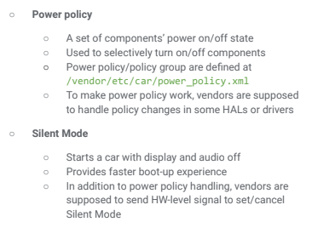
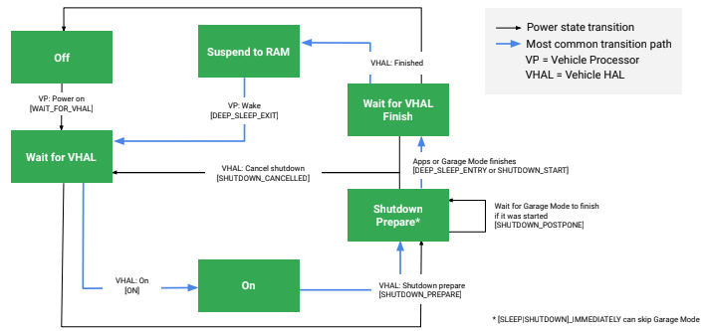
Car Framework
Android 11 & 12
Car Service crash recovery (Android 11)
Watchdog (Android 11)
Service that monitors system health and identifies/terminates badly behaving processes
Details
I/O Overuse Monitoring
Limit the number of written bytes to disk to increase flash memory lifetime (See Tesla)
Configurable through XML with different thresholds
Power Management
Silent Mode – device starts up with display and audio off
CCSEXT-52780

Slide 11
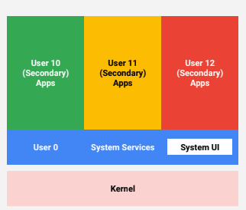
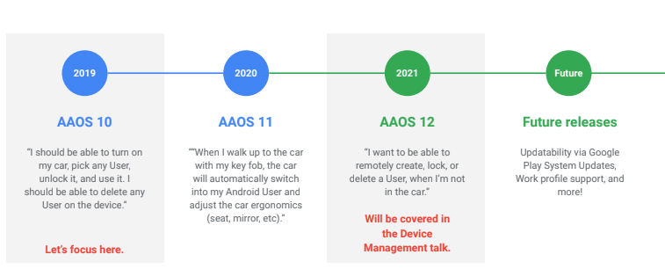
Multi-User (1/2)
Different User Types and Restrictions (Admin, Non-Admin, Guest)
Accounts are associated to an Android user
Performance Optimization for Applications: pre-create Users
CCSEXT-42033
CCSEXT-25471

Slide 12
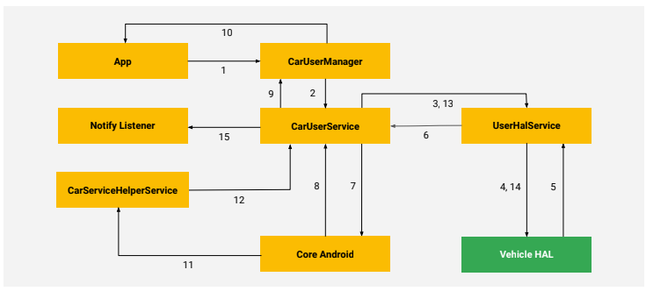
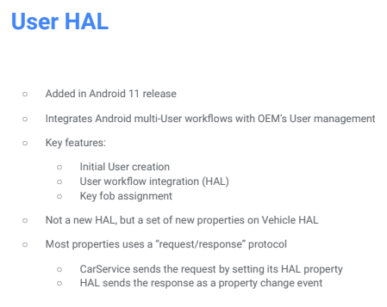
Multi-USER (2/2) – User HAL
Becomes Mandatory (CDD)
More details in Automotive Bootcamp 2020
CCSEXT-25471
CCSEXT-42039

Slide 13
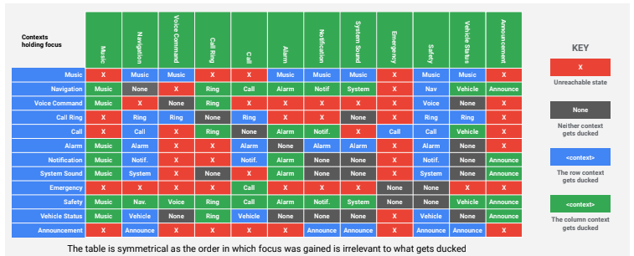
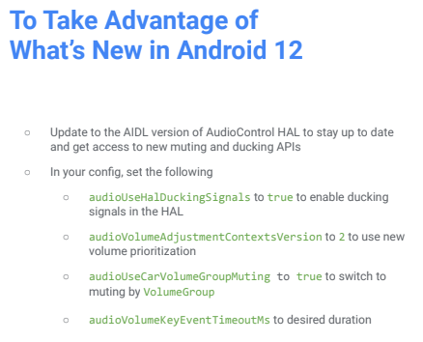
Audio
More flexibility
New Audio Usages (R)
Audio Focus
AIDL Audio HAL
New ducking behavior
CarAudioService will monitor changes in audio focus, and provide the AudioControl HAL with a signal as to what should be ducked
Audio Volume changes
New APIs for Mute Control
Volume Key event timeout (useful for short sounds)
Power Policy for Audio
Multi Zone (Android 11)
CCSEXT-42040

Slide 14
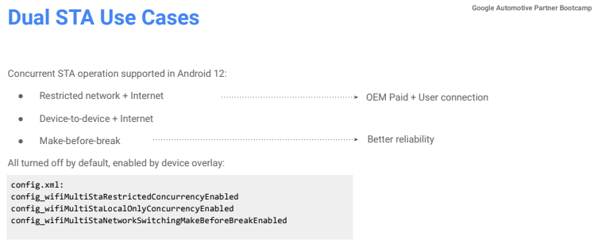
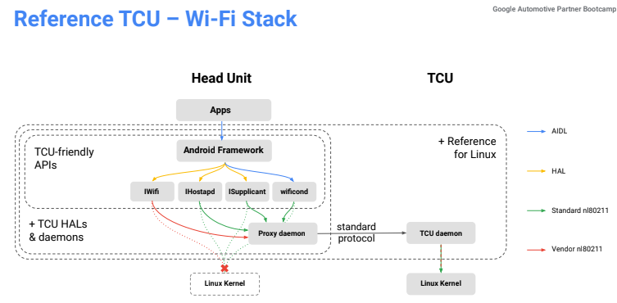
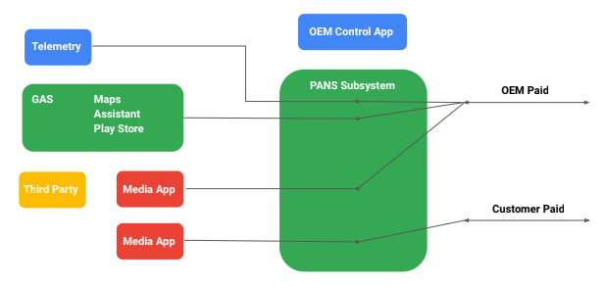
Networking
Dual STA and Per-App Network Selection (PANS)
Do more with Google
Linked with Google Cloud
Analytics
Predictive Maintenance
CCSEXT-42035

Slide 15
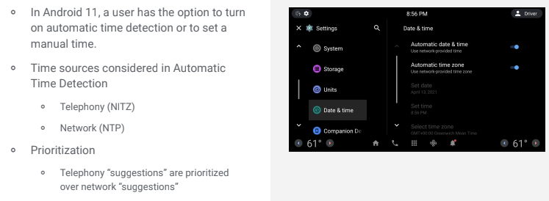
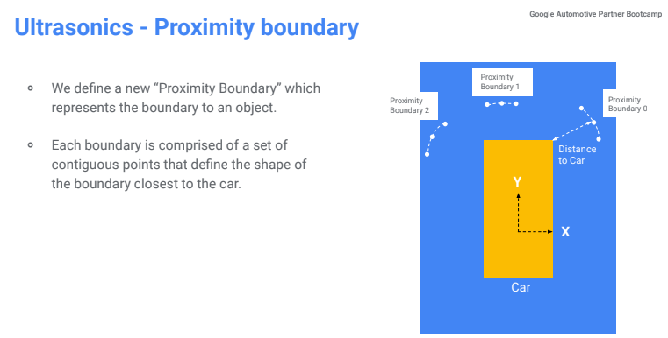
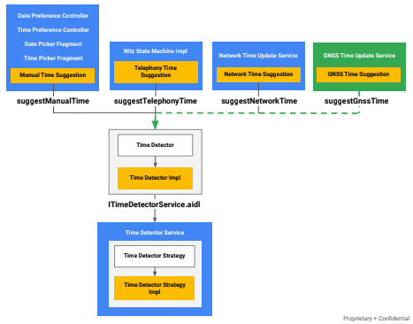
Sensors & Location
Automatic Time Detection – GNSS Time
Impacts to be checked on HMI and AllianceClockService
Update of Ultrasonics HAL
HAL introduced by Android 11. Supports only RAW data
Adds support for receiving processed ultrasonics data
To be studied more deeply
CCSEXT-42041 & CCSEXT-42038

Slide 16
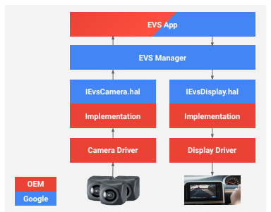
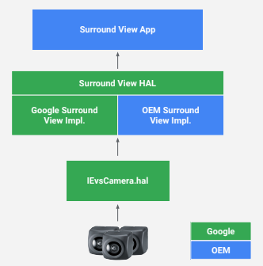
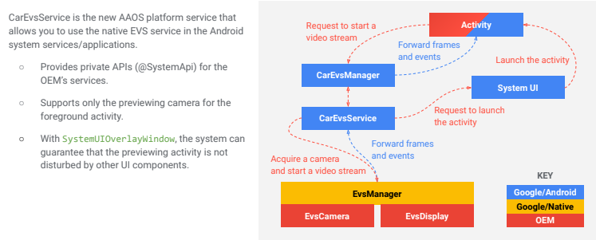
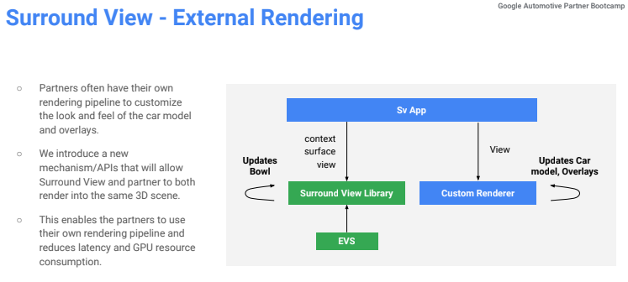
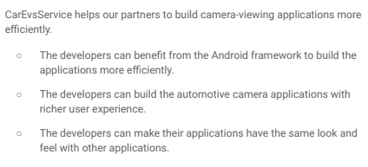
Camera
CarEvsService
Introduced in Android 11 (EVS HAL 1.1)
Not YET mandatory
Surround View
Introduced in Android 11
Requires Camera RAW data
Improved in Android 12 with more features
GPU acceleration (including algorithms)
Online calibration
External renderer
CCSEXT-42041

Slide 17
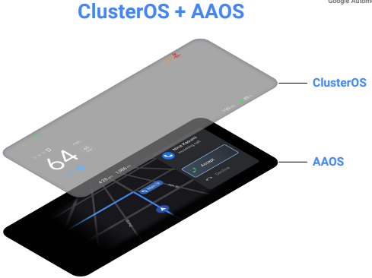
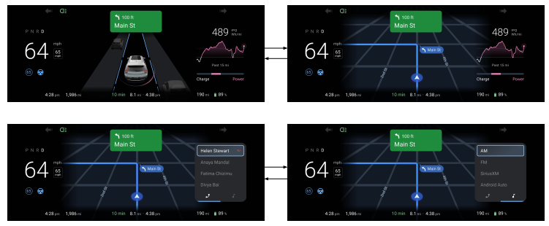
Display & inputs (1/2)
Cluster
Cluster2 – do more inside Android
VHAL properties : CLUSTER_DISPLAY_STATE, CLUSTER_SWITCH_UI, CLUSTER_REPORT_STATE, CLUSTER_REQUEST_DISPLAY, CLUSTER_NAVIGATION_STATE
Cluster Key Handling
Display
ActivityView deprecated in Android 12
What’s new in Android 12 ?
VM Shell
Task View
Task Organizer
Alliance Windows Overlay Service would be impacted
Would be studied more deeply by HMI team

Slide 18
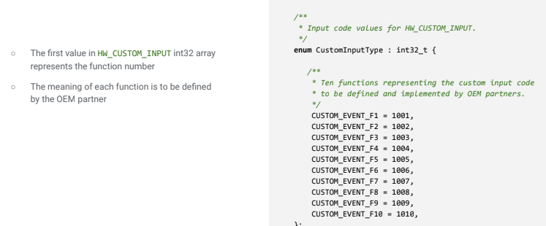
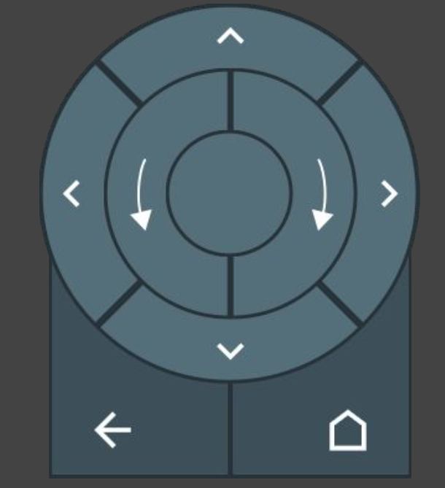
Display & inputs (2/2)
Rotary Switch (Introduced in Android 11)
Be careful about Certification
More details in previous bootcamp
Required for Nissan
OEM Custom Input Event
Allow to implement complex events (ex: Navigate to Home)
VHAL : HW_CUSTOM_INPUT
Alliance Car Input Service to be checked
CCSEXT-25472
CCSEXT-53781

Slide 19
Others
New VHAL for HVAC temperature (better Google Assistant integration)
Bluetooth
Better support of MAP profile
AVRCP Cover ART Support, Multi Device Audio Support (Control Several Sources through AVRCP)
Automatic reconnection based on VHAL, Fast Pair (over BLE)
Virtialization (based on VirtIO)
Available in Android 11 QPR3
Calendar App
Should we need to link with PreSoak ?

Slide 20
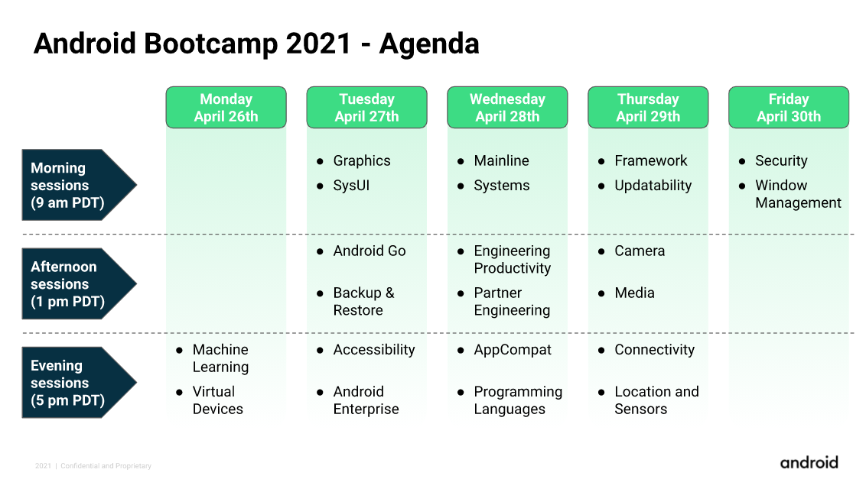
AGENDA

Slide 21
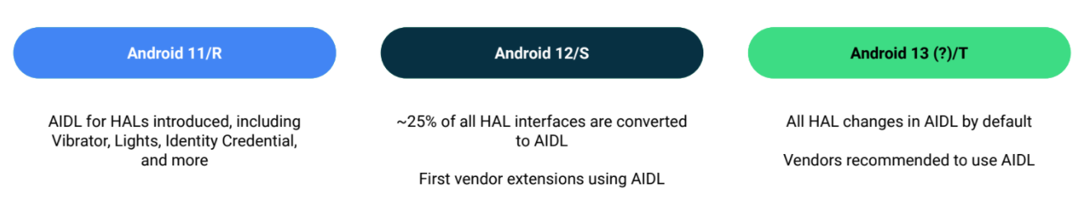
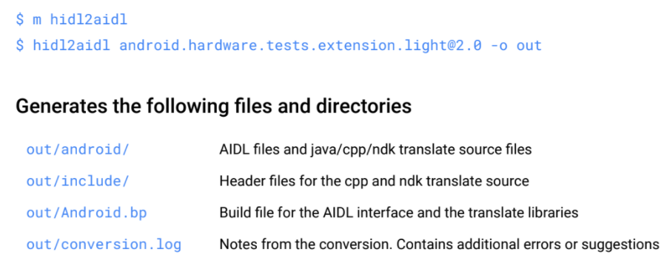
AIDL – A UNIFIED IDL For Android
HIDL interfaces moving to AIDL
Backwards compatible
Google recommends to use AIDL for HAL extension
Tool to convert
FMQ available in AIDL
Supports union

Slide 22
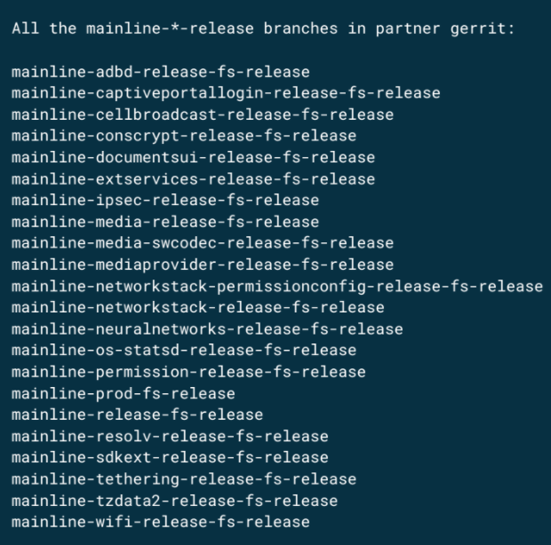
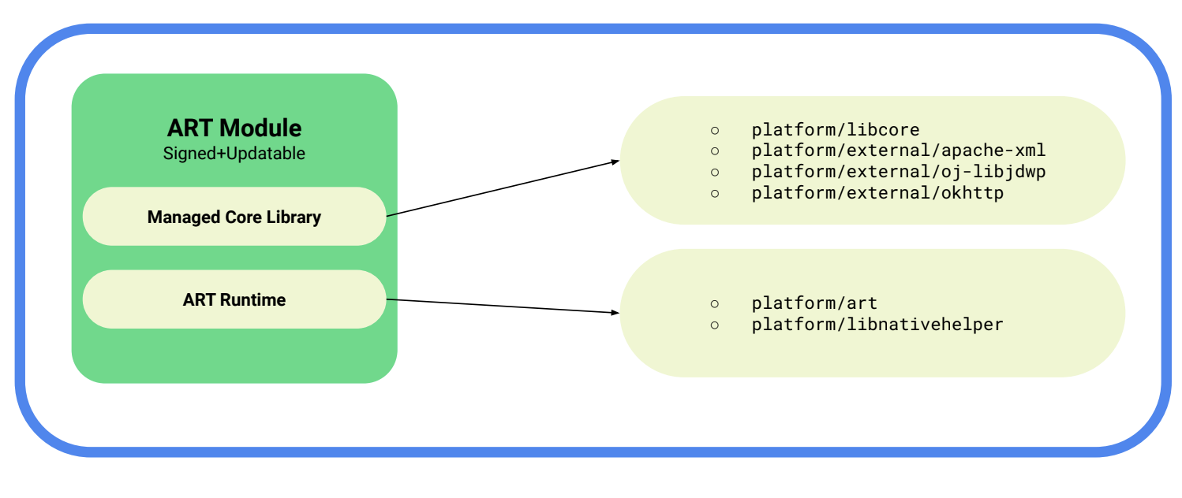
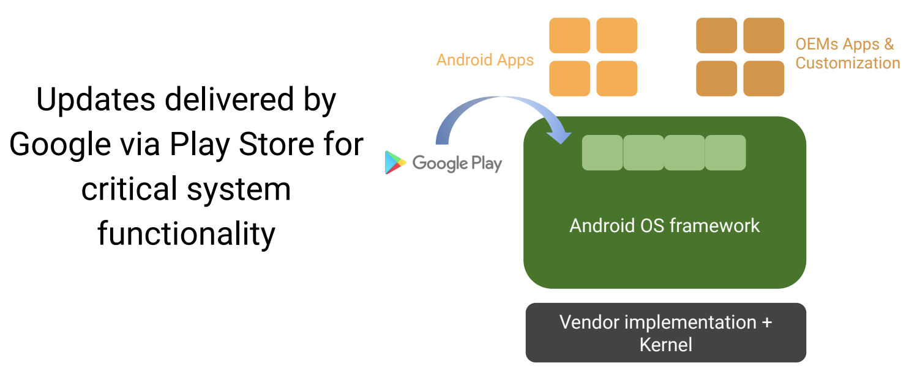
Mainline
Stable ABI for modules
Test Suite : MTS
Improvements
Seamless resume on reboot
De-duplication of Dynamic Libraries
Pre-installed APX compression

Slide 23
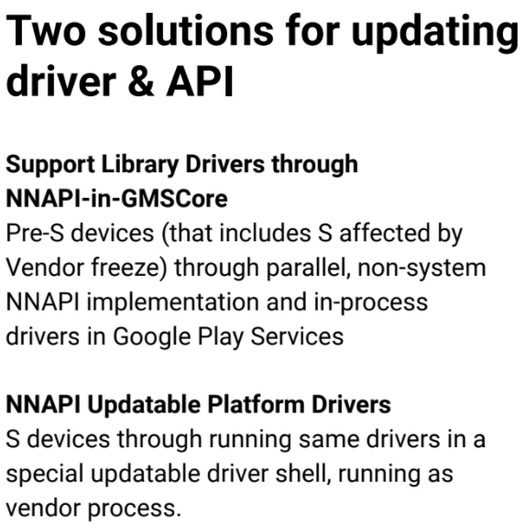
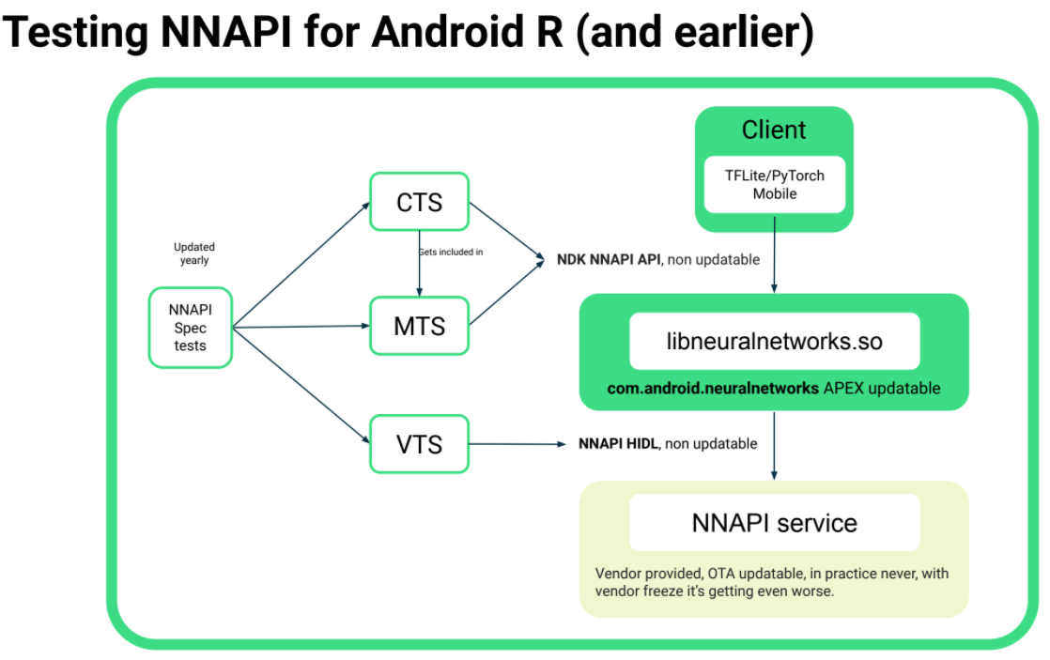
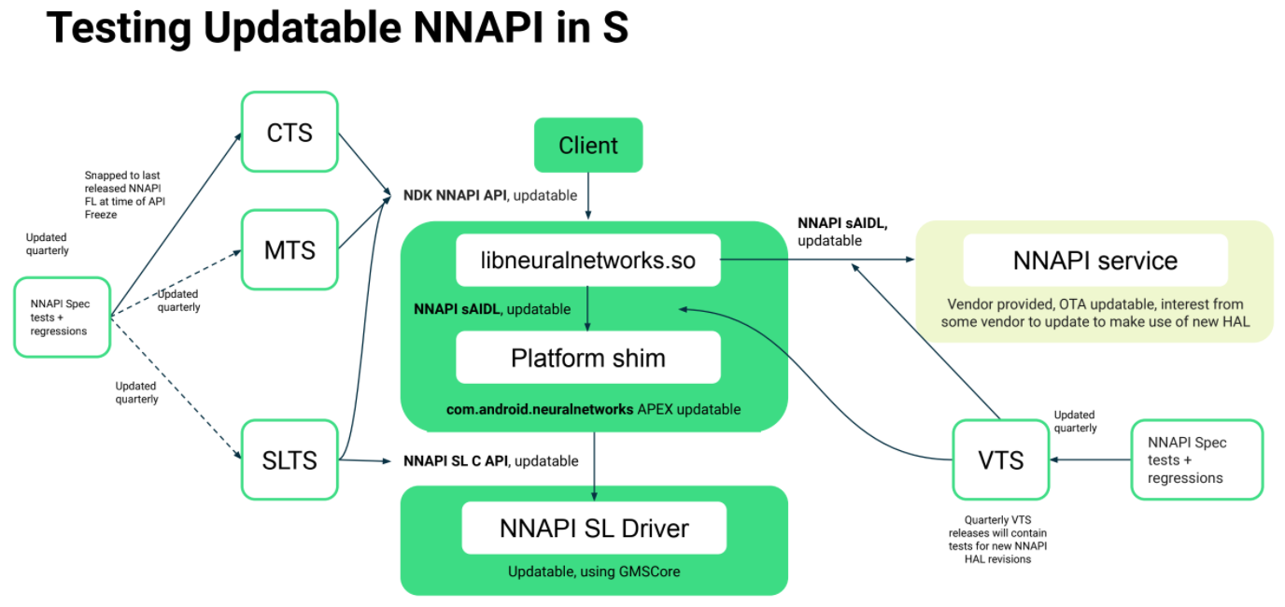
Machine Learning – NNAPI Updatable driver
Problem to solve
Define stable APIs
More frequent updates (Quaterly)
From S, NNAPI would be updated quaterly
Each quaterly release will introduce feature level
Moving HAL to stable AIDL

Slide 24
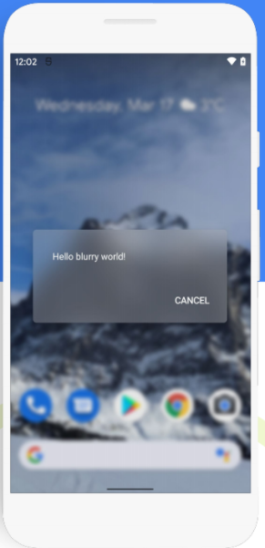
GRAPHICS
Blur
Native Image decoding APIs
https://developer.android.com/ndk/reference/group/image-decoder
Android Dynamic Performance Framework (ADPF)
Thermal API to reduce throttling
Strongly recommended in Android 12
Probably Must in Android 13
GPU profiling
Surface Flinger caching (experimental)
dEQP : (drawElements Quality Program) is the Khronos test suite for EGL, GLES, and Vulkan.
Level (allows more frequent updates)

Slide 25
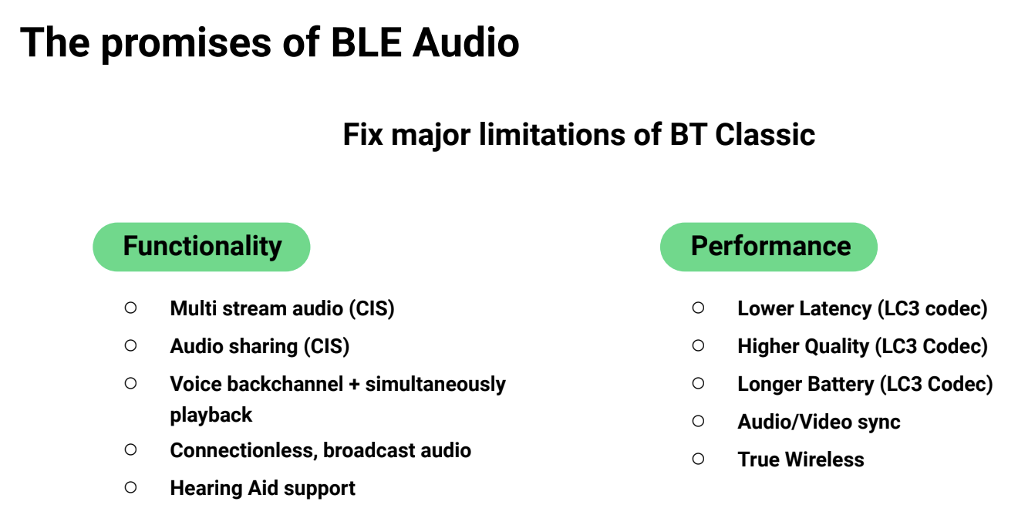
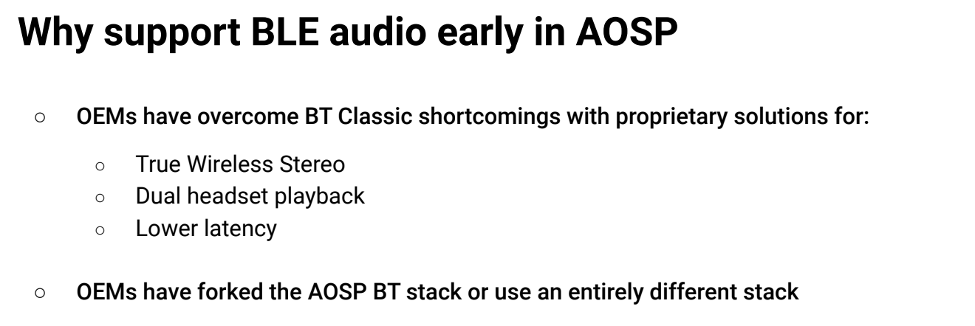
Audio
Support Audio Bluetooth Low Energy
Audio Haptic Generator Effect
Multi-channel Audio
Increased maximum number of channels supported by PCM mixer from 8 channels to 12 channels
Audio effects (up to 24 channels) for post-processing and pre-processing
Add MPEG-H audio format for passthrough
Audio HAL 7.0
Prepare move to AIDL
Vendor tags in AudioMetadata

Slide 26
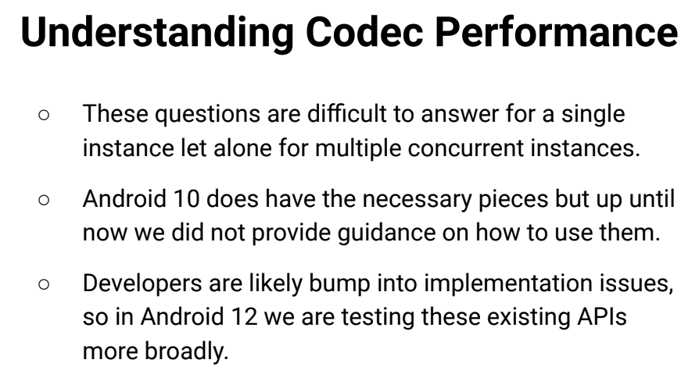
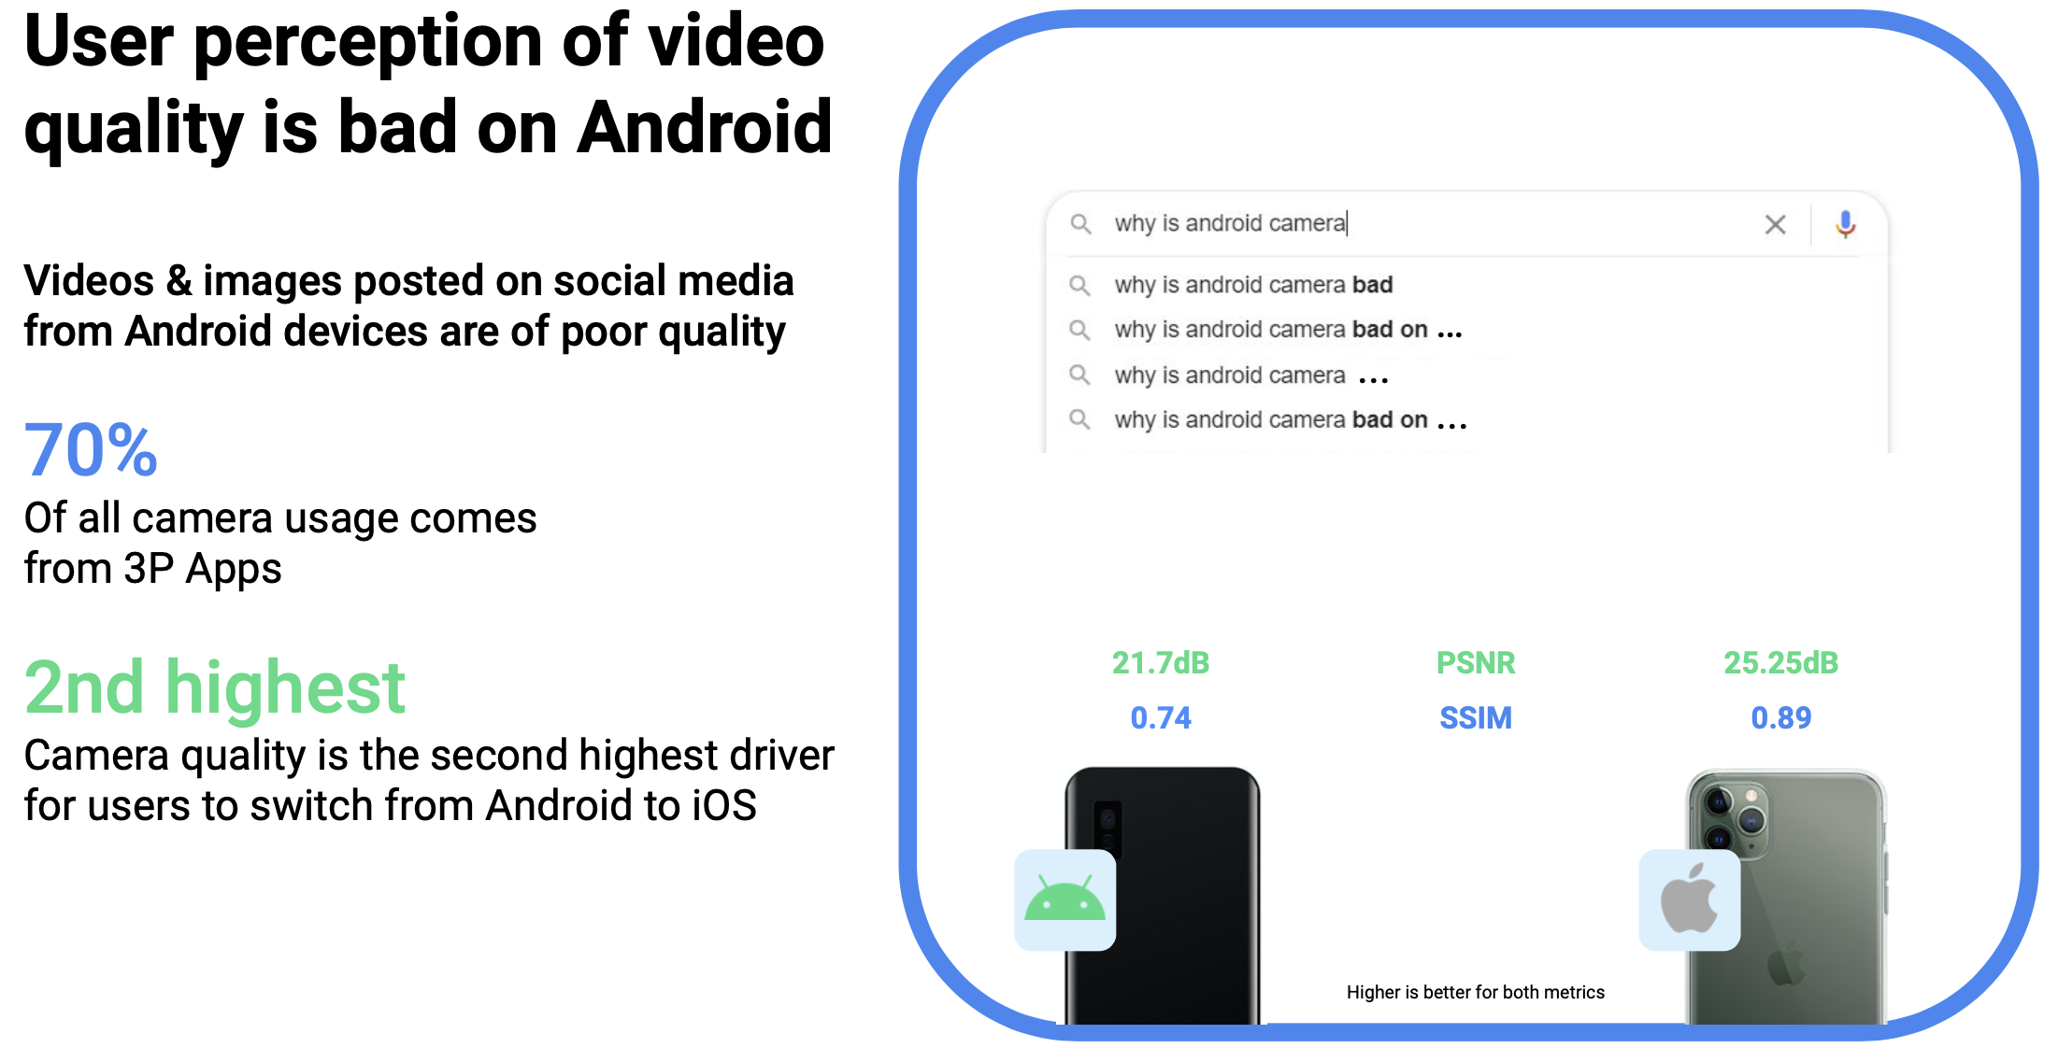
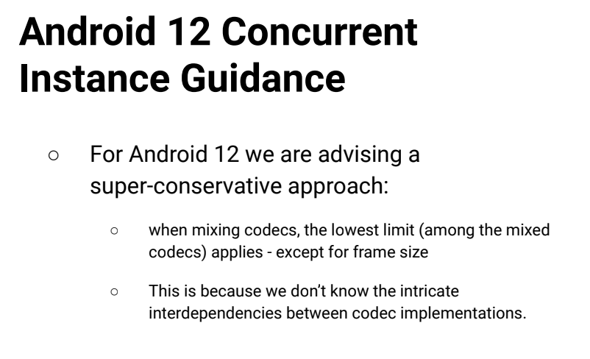
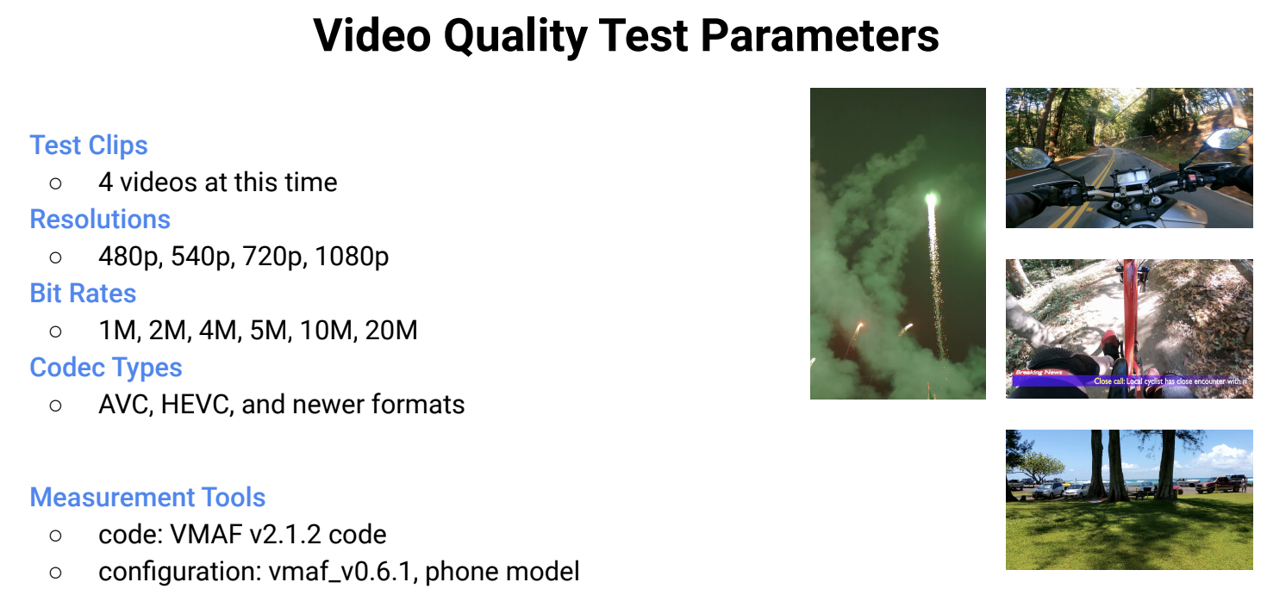
Camera / Codec
Camera Performance Issue
New tests
Codec Performance Issue
Single Instance
Acheivable Rate APIs
Multiple Instance
New CTS: Operating Rate Enforcements for HW video codecs

Slide 27
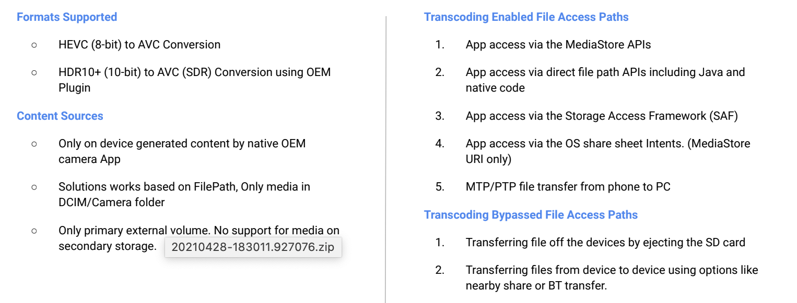
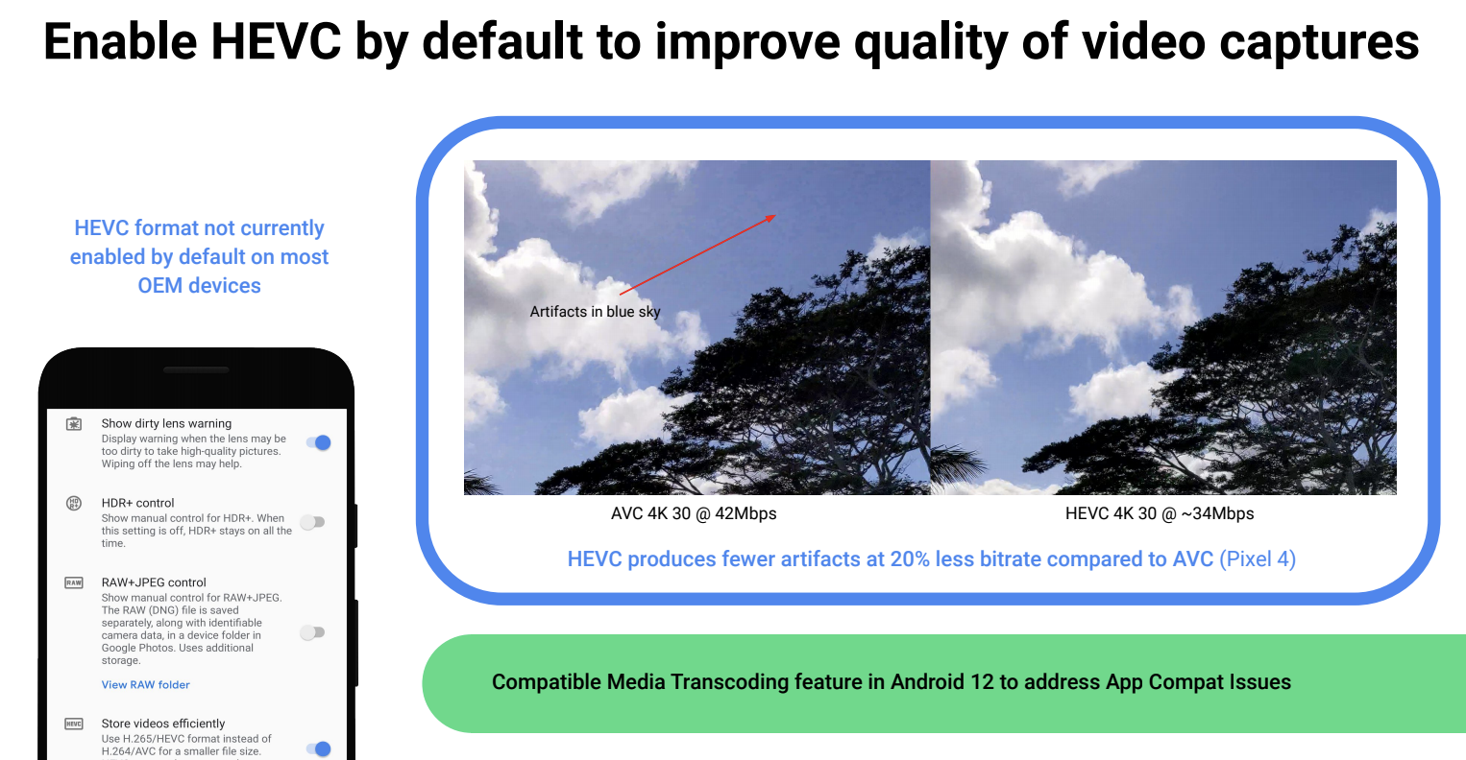
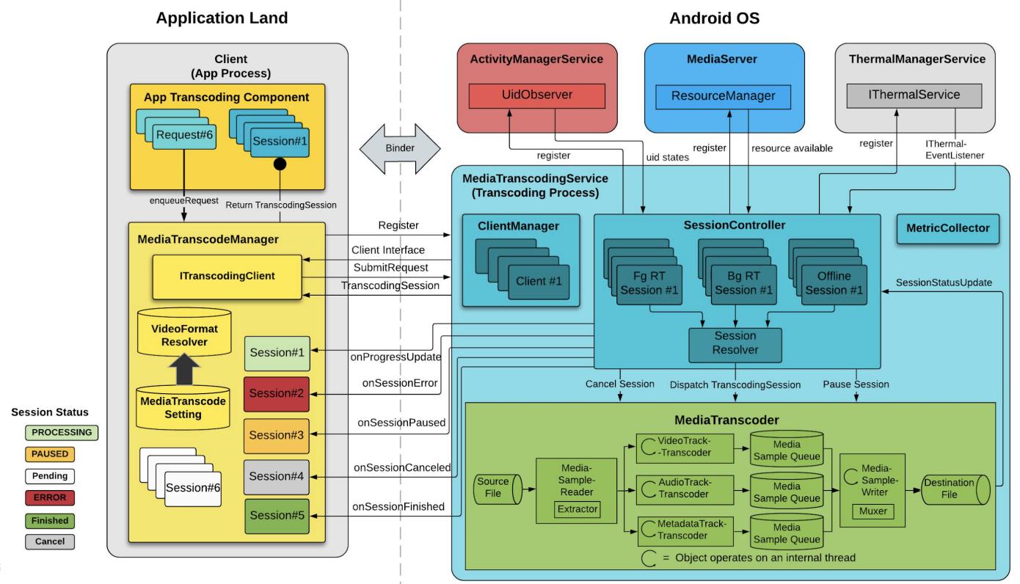
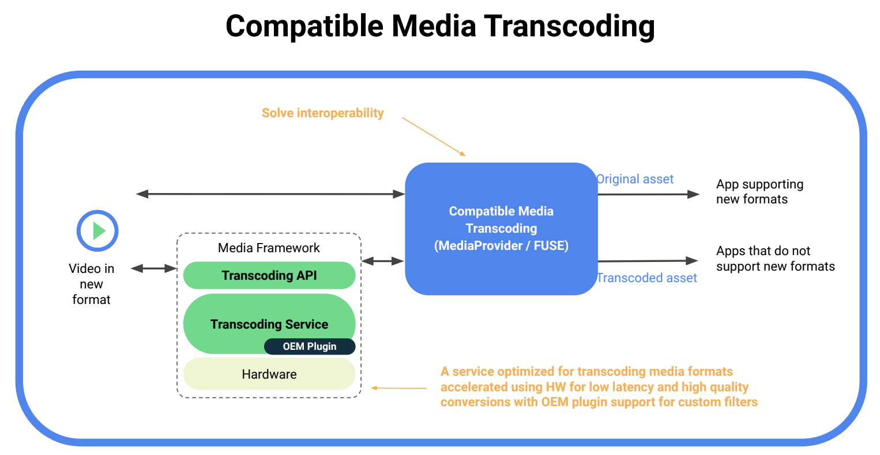
MEDIA TRANSCODING
Android 12 Scope
Architecture
Problem to solve

Slide 28
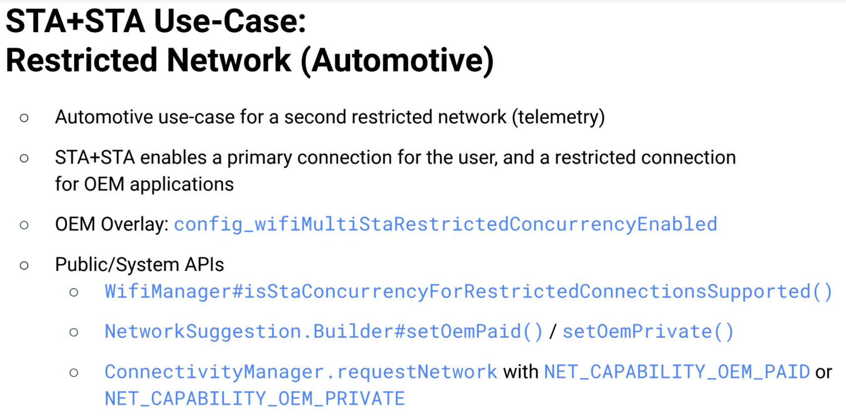
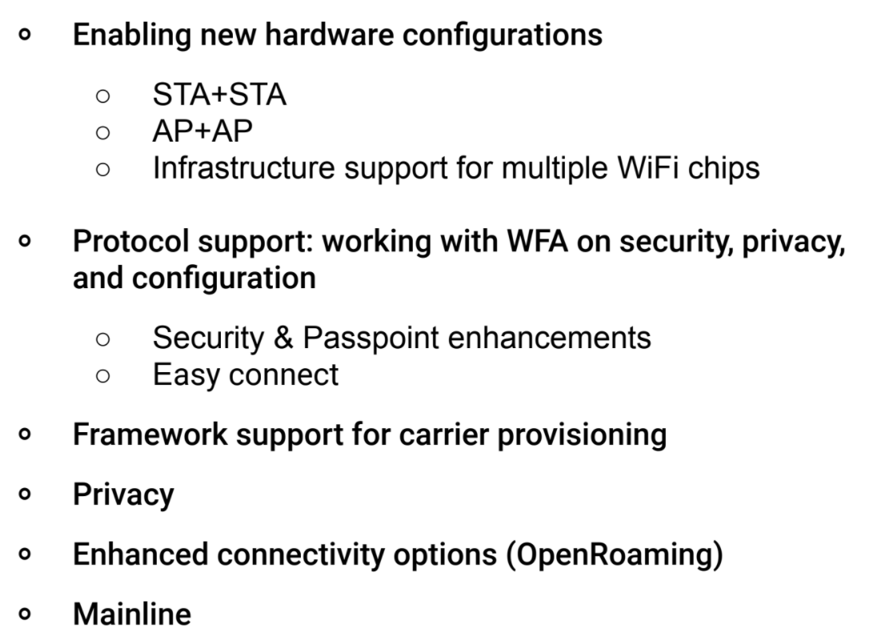
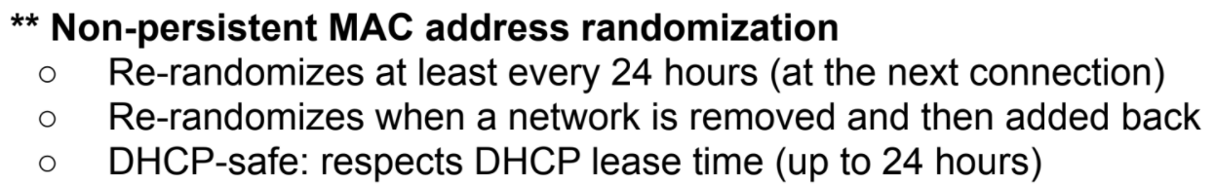
WIFI
2.4 GHz / 5 GHz on 1st chip
60 GHz on 2nd chip
Recommended in Android 12
Mandatory in Android 14

Slide 29
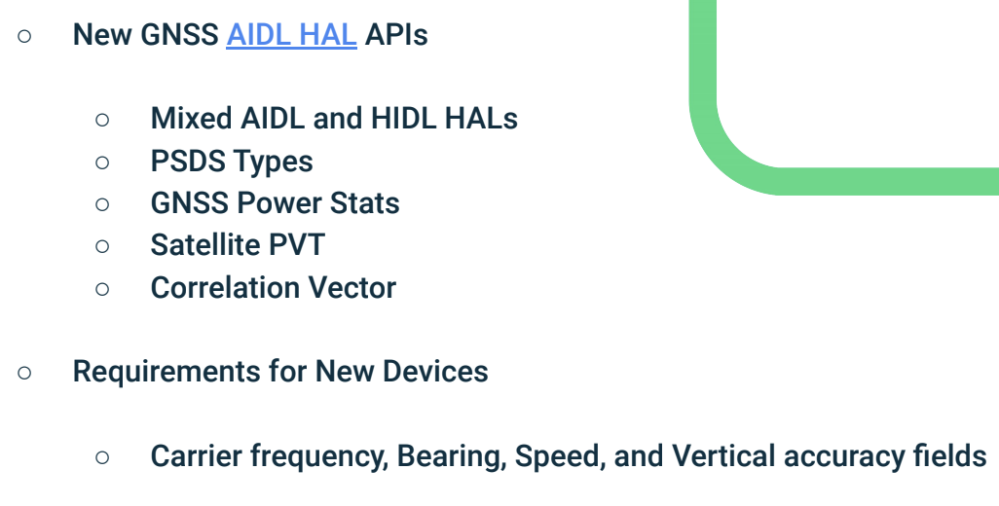
GNSS
Predicted Satellite Data Service
Provides Power information
Optional : Position, Velocity, Time Information

Slide 30
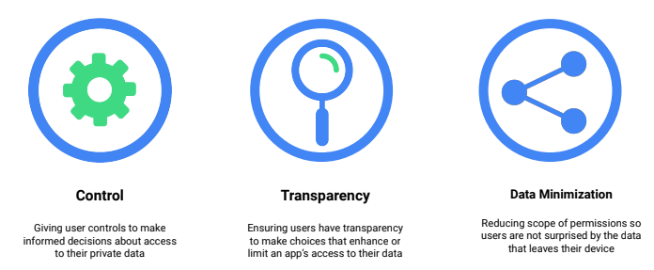
PRIVACY
Approximate location access
Mic & camera toggles
Rate limiting sensor sampling rate
Clipboard read notification
Mic & camera indicators
Decouple Bluetooth scanning
permission from Location
App hibernation

Slide 31
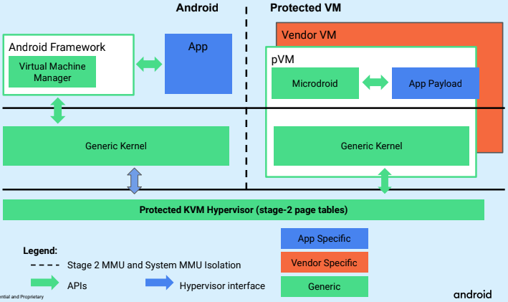
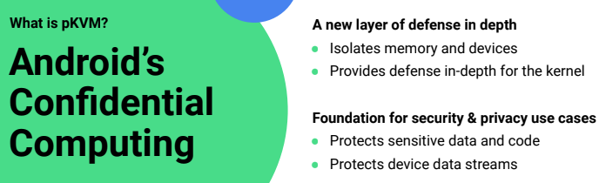


Hypervisor – pKVM Virtual Machines
Protected Virtual Machines
Microdroid is a headless Android optimized for pVM
What is protected KVM

Slide 32
Other
Boot Optimization
Android Test Station
Bazel – a new build tool post Android 12
Repo submodule
Libc : Compressed Logs
RUST – a new native language
https://www.rust-lang.org/
64 bits only
Possible in Android S, Targeted in Android T
Interesting for AccessDA to reduce RAM
Foreground Service Restriction
Context Hub
Car Crash Detection
System UI – Widget update
System Font Customization
Security
Remote Key Provisioning (starting in 2022)
Hypervisor (Target Android T)
Reduce prelaoded apps (and pre-granted permissions).
Biometrics
Refactor (System Server cleanup)
HAL moved to AIDL
Update CDD requirements for Biometics / Face
And much more…
Window Management
Jeckpack
Multi-Display
…

Slide 33
Conclusion
Project Mainline
Some components would be provided by Google and updatable by PlayStore
New Test Suite MTS
Moving from HIDL to AIDL
Converged solution
25% HAL in AIDL
Security / Performance
CDD updates => New CTS tests
Big changes in Android T
Bazel
Full AIDL
Hypervisor

